Slide 1
Outline
Introduction to Project
Problem Formulation
Objectives of the work
Methodology used
Results and Outputs
Conclusion
Future Scope
References

Slide 2
Introduction to Project
Home security systems are networks of integrated electronic devices working together with a central control panel to protect against burglars and other potential home intruders.
A home security system is a network of devices designed to protect your home from intruders, accidents, and other emergencies.
It typically includes components like door and window sensors, motion detectors, security cameras, alarms, and a central control panel.
These devices work together to monitor and secure your home, providing you with peace of mind and the ability to respond quickly to any potential threats or incidents.

Slide 3
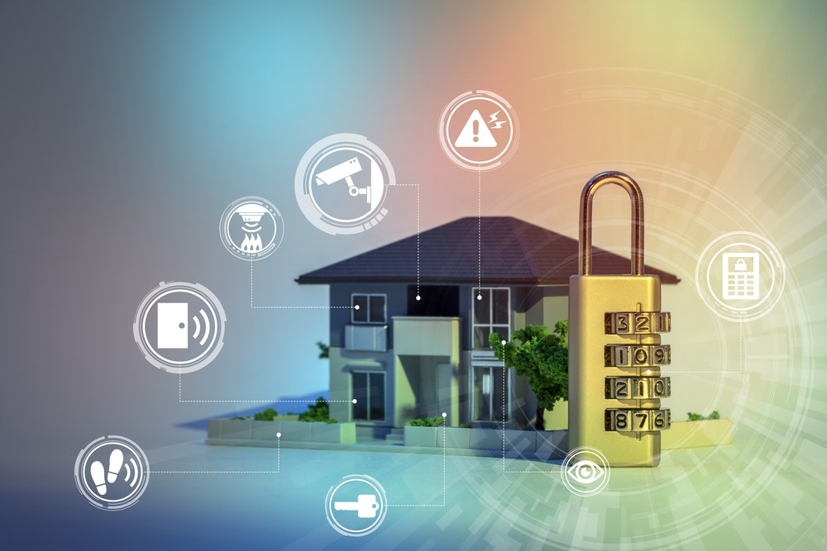
A basic home security system includes:
A control panel
Door and window sensors
Motion sensors
Glass break sensors
Security cameras
Modern security systems have evolved from simple alarm setups to sophisticated networks that encompass various technologies.
Door and window sensors—also called contact or entry sensors—are comprised of two parts. They're installed right next to each other on a closed door and door frame (or closed window and window frame).

Slide 4
Problem Formulation
Design an effective and reliable home security system that employs a combination of physical and digital measures to deter, detect, and respond to potential security threats.
Integration of Sensors: Incorporate various types of sensors, such as motion sensors, door/window sensors, glass-break sensors, and smoke detectors, strategically placed throughout the home to cover entry points and vulnerable areas.
Surveillance Cameras: Install indoor and outdoor cameras with night vision and high-resolution capabilities. Implement continuous recording as well as motion-triggered recording. Ensure secure storage and remote access to camera feeds.

Slide 5
Smart Locks: Integrate smart locks for doors and windows that can be controlled remotely through a mobile app. Provide features like temporary access codes for guests and family members.
Mobile Application: Develop an intuitive mobile application that allows homeowners to monitor the security system in real time, receive instant alerts, view camera feeds, and control smart devices from anywhere.
Alert System: Implement a robust alert system that sends immediate notifications to homeowners via SMS, email, or push notifications on their mobile devices when a breach is detected or a sensor is triggered.

Slide 6
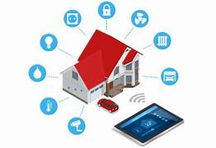
Objectives of the Work
The objective of implementing a comprehensive home security system is to create a robust and multi-layered defense mechanism that safeguards the residents and property from potential security threats.
This system aims to deter and detect unauthorized access, break-ins, and other security breaches through the integration of state-of-the-art surveillance cameras, motion sensors, door/window sensors, and smart access controls.
By providing real-time alerts, remote monitoring capabilities, and seamless integration with smartphones and other devices, the security system seeks to empower homeowners with the ability to proactively respond to any potential security incidents.
Ultimately, the goal is to enhance the safety, peace of mind, and overall well-being of the residents while maintaining the privacy and convenience of home living.

Slide 7
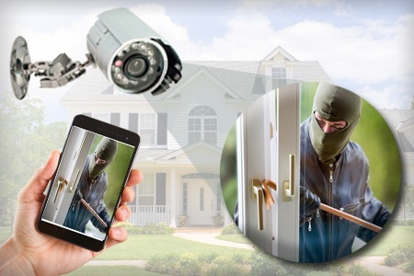
Methodology
Research Design: Describe the overall research approach, such as whether it's a quantitative, qualitative, or mixed-methods study. Explain why the chosen approach is suitable for addressing the research objectives.
Data Collection: Detail the methods used to gather relevant data. This may include surveys, interviews, literature reviews, and market research to understand existing security technologies and user preferences.
Requirements Analysis: Explain how you identified the security needs and preferences of homeowners. Describe any consultations with experts, residents, or stakeholders to gather insights into the desired features and functionalities of the security system.
System Architecture: Describe the proposed architecture of the home security system. This includes how different components interact, such as cameras, sensors, alarms, and the central control unit. Explain any integration with smart home platforms or mobile apps

Slide 8
Results and Outputs
There are a variety of mobile applications available that aim to provide security for women. Some of these applications have features such as emergency alerts, GPS tracking, and safety tips. Here are a few examples:
Safetipin: This app uses GPS tracking to identify safe routes and areas, and also provides a safety score for each location. It also has an SOS button that can be used to send an emergency alert to pre-selected contacts
Hollaback!: This app aims to prevent street harassment by allowing users to document and report incidents of harassment. It also provides resources and information on how to respond to harassment.
While these applications can provide additional security for women, it is important to remember that they should not be relied on as a sole solution to the issue of violence against women. It is also important to educate and empower women on ways to protect themselves and to address the root causes of gender-based violence

Slide 9
Conclusion
In conclusion, the implementation of a comprehensive home security system represents a significant step forward in enhancing residential safety and security.
Through a meticulous research process, we identified the crucial security needs and preferences of homeowners, leading to the design of a technologically advanced system that integrates surveillance cameras, motion sensors, access controls, and real-time alerts.
Our findings highlight the effectiveness of such a system in deterring potential intruders and providing homeowners with timely notifications about security incidents. The successful development and testing of the prototype system underscore its potential to significantly reduce the vulnerabilities associated with residential security.
Moreover, the iterative design process, informed by user feedback and real-world testing, demonstrates the adaptability and responsiveness of the system to evolving security needs.

Slide 10
References
1. Smith, S., & Brooks, M. (2017). Home Automation Security System Using Arduino and GSM. International Journal of Advanced Research in Computer Science, 8(4), 1052-1055.
2. Chen, C. W., & Wu, C. H. (2019). Smart Home Security System with Fuzzy Logic and IoT Technologies. IEEE Access, 7, 114437-114448.
3. Brown, G. Z. (2017). Home Security Systems: Prevention and Protection. CRC Press.
4. Chaudhary, A., & Charaya, S. (2020). IoT-based Smart Home Security System. In Advances in Electronics, Communication and Computing (pp. 33-40). Springer, Singapore.
5.Rai, A. K., & Narang, N. (2018). Home security and automation systems using Internet of Things(pp. 1-4). IEEE.

